Slide 1


Level One Project and Principles – Part 1
Mojaloop Convening
Kigali November 2024
The Level One Project is an initiative of The Bill & Melinda Gates Foundation
1

Slide 2



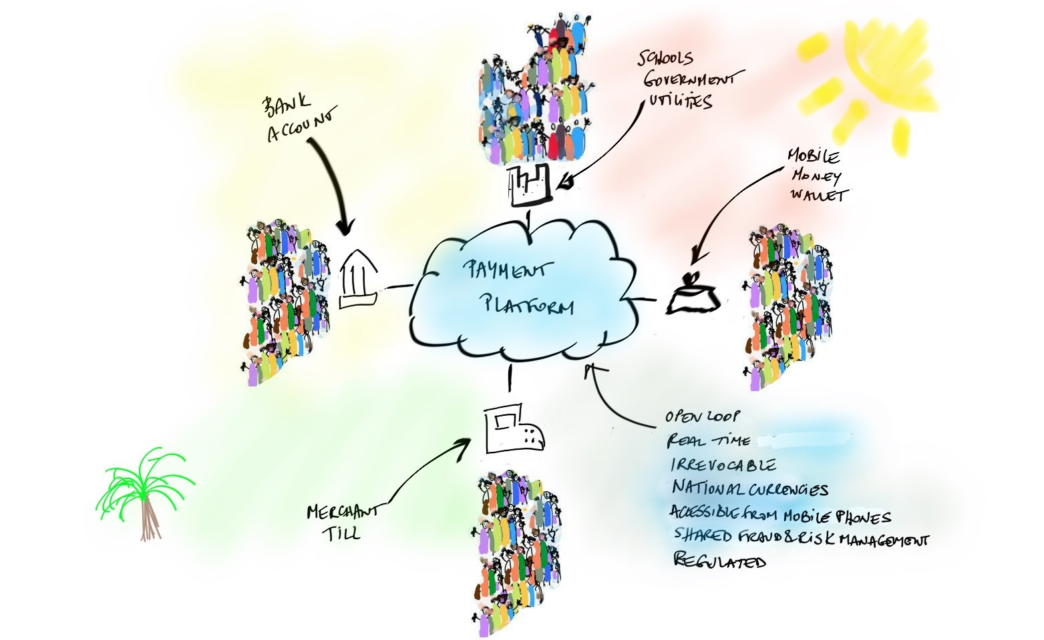


Level One Project
Affordability
Low Cost Scale Safe
Usefulness
Reliable Inclusive Ubiquitous
Provides a vision for an inclusive instant payments system that supports inclusive, interoperable digital economies, and the design principles to meet user requirements
Develops a set of tools and resources to enable the implementation of a real-time retail payment system that is aligned with the Level One Project principles
Shares a blueprint for how such a system could be configured within a country or region
Bill & Melinda Gates Foundation, 2024

Slide 3
About the Level One Project
The Level One Project is an initiative of the Bill and Melinda Gates Foundation’s Inclusive Financial Systems (IFS) program.
Objectives
Increasing low-income people’s capacity to weather financial shocks and capture income- generating opportunities
Generating economy-wide efficiencies by digitally connecting large numbers of low- income consumers and those that they transact with
The Level One Project points out the necessity for a low cost, inclusive, interoperable digital payments systems to achieve these objectives.
Bill & Melinda Gates Foundation, 2024
3

Slide 4

How Does the Level One Project Enable Inclusive, Instant Payments Systems (IIPS)?
Provides a vision for an inclusive instant payments system that supports inclusive, interoperable digital economies, and the design principles to meet user requirements
Shares a blueprint for how such a system could be configured within a country or region
Develops a set of tools and resources to enable the implementation of a real-time retail payment system that is aligned with the Level One Project principles
Bill & Melinda Gates Foundation, 2024
4

Slide 5
Level One Project Focus
The Level One Project remains focused on enabling financial inclusion by meeting the needs of low- income and women end users—both individuals and merchants—as well as the digital financial service providers (DFSPs) that serve them.
Affordability
Low Cost
End users are willing and able to pay for the cost of preferred products and receive value in excess of cost
Scale
The cost of the system is spread across a huge volume of payments, making the cost per transaction very low
Safe
Parties in the instant payments ecosystem can use services securely without concern about fraud loss
Usefulness
Reliable
Users’ money and information are secure and available for use
Inclusive
Any end user can pay any other end user
Ubiquitous
End users can send and receive payments for all necessary purposes and use cases
Bill & Melinda Gates Foundation, 2024
5

Slide 6
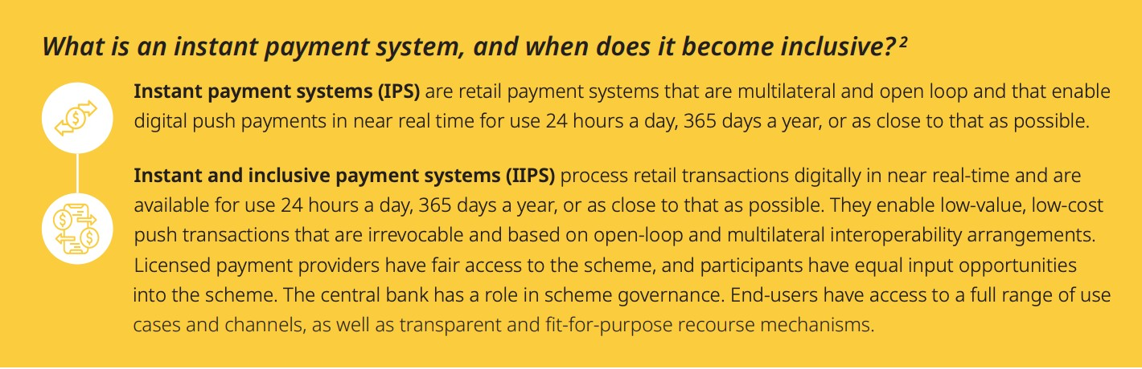
What’s Inclusive?
“In the context of describing a payment system or linkage, it refers to a design that is intended to meet the needs of low-income end users.”*
Emphasis added
Bill & Melinda Gates Foundation, 2024
Sources: *UNCDF Migration & Remittances Program, Bridging Borders; 2024** AfricaNenda, SIIPS Report, 2022.
6

Slide 7
Fundamentally, There are Two Types of Payment Systems
Open-loop
Payer
DFSP
Payment System
DFSP
Payee
Closed-loop
Payer
DFSP
Payee
Bill & Melinda Gates Foundation, 2024
7

Slide 8
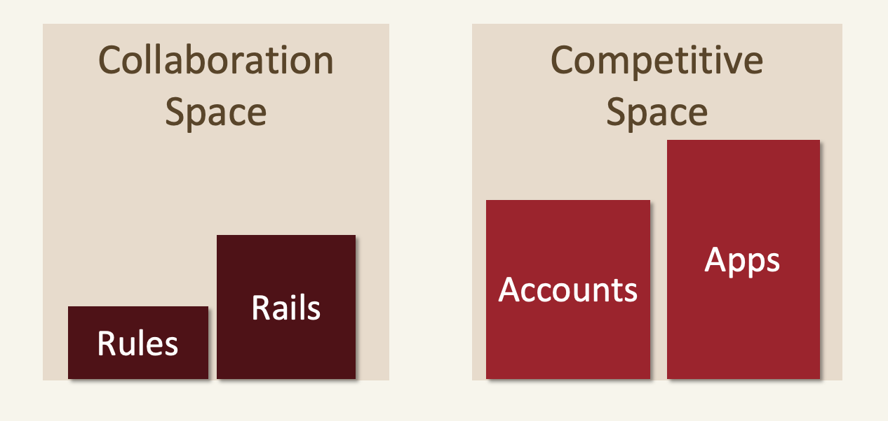
Is there a Competitive Ecosystem?
Supports multiple entrants - both incumbents and new entrants
Supports business models for sustainable profit when transactions and account fees are zero or low
Enables commerce and finance adjacencies
Bill & Melinda Gates Foundation, 2024
8

Slide 9
IIPS Platform Capabilities
IIPS
Payer
DFSP
DFSPs
Payee
Scheme
Operating
Platform
Switch Directory Settlement Fraud Management
Settlement Bank
Bill & Melinda Gates Foundation, 2024
9

Slide 10
An Instant Payments System
A faster, retail payment system
Financial Institution
Instant System
Financial Institution
Payer
Payee
Exists alongside other national payments systems
ACH
CARD
End User
Banks
Banks
End User
RTGS
Bill & Melinda Gates Foundation, 2024
10

Slide 11
Scheme Choices Can Influence Performance
Data shown is through 2023
Annual Transactions per Capita since System Launch
200
180
Brazil (Pix) hit 41 tx/capita in first year
160
140
120
100
80
60
40
20
0
Year 1
Year 2
Year 3
Year 4
Year 5
Year 6
Year 7
Year 8
Year 9
Australia NPP (Feb 2018) Mexico SPEI (Aug 2004)
UK Faster Payments (May 2008)
Brazil Pix (Nov 2020) Singapore FAST (Mar 2014) USA RTP (Nov 2017)
India UPI (Apr 2016) Sweden BIR (Dec 2012) USA Zelle (June 2017)
Bill & Melinda Gates Foundation, 2024
Source: Glenbrook analysis from respective payment system data. 11

Slide 12






IIPS L1P Design Principles – Common Features
Irrevocable Push, Credit Transfer
Account to Account
Instant Availability
Low Cost
24/7/365
Mobile Ready
Bill & Melinda Gates Foundation, 2024
Source: Glenbrook Partners
12

Slide 13
IIPS Other L1P Design Principles
Scheme Design
Interoperable: DFSPs (Digital Financial Services Providers), including both banks and licensed non- bank transaction account providers, are eligible to be direct participants in the scheme
3rd Party Connections: Non-licensed specialty aggregators, processors, and other similar entities may connect to the system (as non Participants) to perform various functions on behalf of end users or DFSPs, when sponsored by a participating, licensed DFSP
Scale: The scheme supports key retail use-cases, including P2P, P2B, P2G, B2P, B2B, B2G, G2P, G2B Settlement: The financial obligations among the DFSPs are settled on, at least, a same-day basis End User Account Type: Accounts of end users are pre-funded, not credit accounts
Fraud Utility: The scheme operates a shared fraud management utility. DFSPs may operate or subscribe to additional fraud management services as they deem appropriate to manage risk for their customers
Directory Services: The scheme uses a directory that enables appropriate aliases for payments addressing – options include, but are not limited to phone number, account number, national ID, email address or other identifier. Using a non-phone number identifier may be important for ensuring privacy and should be available for users who prefer them
Bill & Melinda Gates Foundation, 2024
13

Slide 14
What Technical Design Choices Can Enable an Inclusive Scheme?
Technology
Appropriate technologies support secure, high volume, low cost, irrevocable real-time payments, securely and protecting user privacy.
Identifiers / Directory
The directory enables appropriate aliases for payments addressing – including, but not limited to phone number, account number, national ID, email address or other identifier. Non-phone number identifiers may be important for ensuring privacy and should be available.
System Components
A central platform, as defined by scheme rules, provides at least switching, directory, settlement, and fraud management services to participants.
Common Core
All use cases leverage the same underlying payment order and settlement protocols.
Additional Protocols
Additional technical protocols support use case specific needs, such as Request to Pay, QR code, and third party payments initiation.
_{System Connections} The system is designed to connect to other appropriate domestic systems, and to support cross-border retail use cases.
Other features also add to inclusivity: technology enables non-banks to participate, technology lowers costs to participate, technology reduces hub operating costs
Bill & Melinda Gates Foundation, 2024
14

Slide 15
Mojaloop OSS
A reference implementation of the Level One Project’s core principles
Benefits
opportunity to own and payments platform
lower cost of development and operations, faster return on investment
lower costs to DFSPs and end users
IS a code base for an interoperable payments platform to connect all digital financial providers and customers, especially the financially excluded
IS NOT a financial product or application itself
15

Slide 16
Scale is Imperative in IIPS
Potential: under US$ 0.01
(Txn Processing Fee to DFSP)
Scale is critical to achieve low costs (and vice versa)
“Pay anyone, get paid by anyone”
Scale is critical to achieve ubiquity
Bill & Melinda Gates Foundation, 2024
16

Slide 17
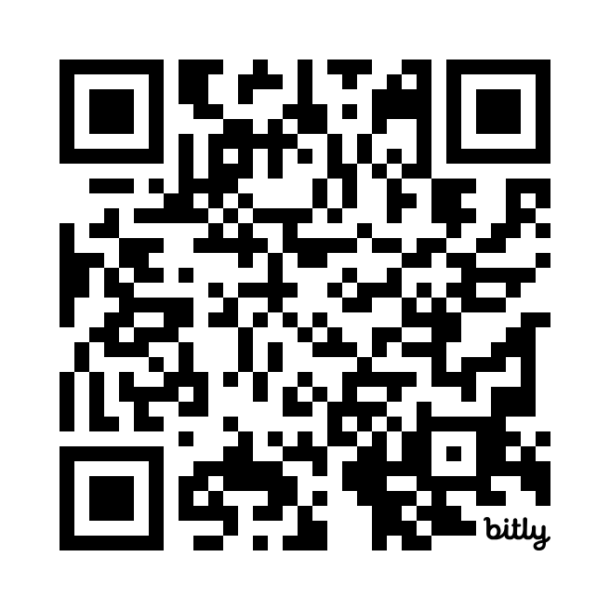
We need your input!
Tell us what you’d like to see in the next Level One website.
What resources do you need to design and build your IIPS?
URL:
bit.ly/L1Pwebsurvey
17

